Slide 1
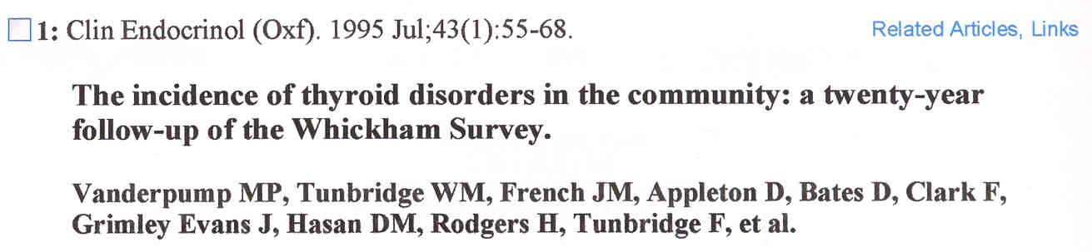
TSH LIMITS
A logit model indicated that increasing values of serum TSH above 2mU/l at first survey increased the probability of developing hypothyroidism which was further increased in the presence of anti-thyroid antibodies.

Slide 2
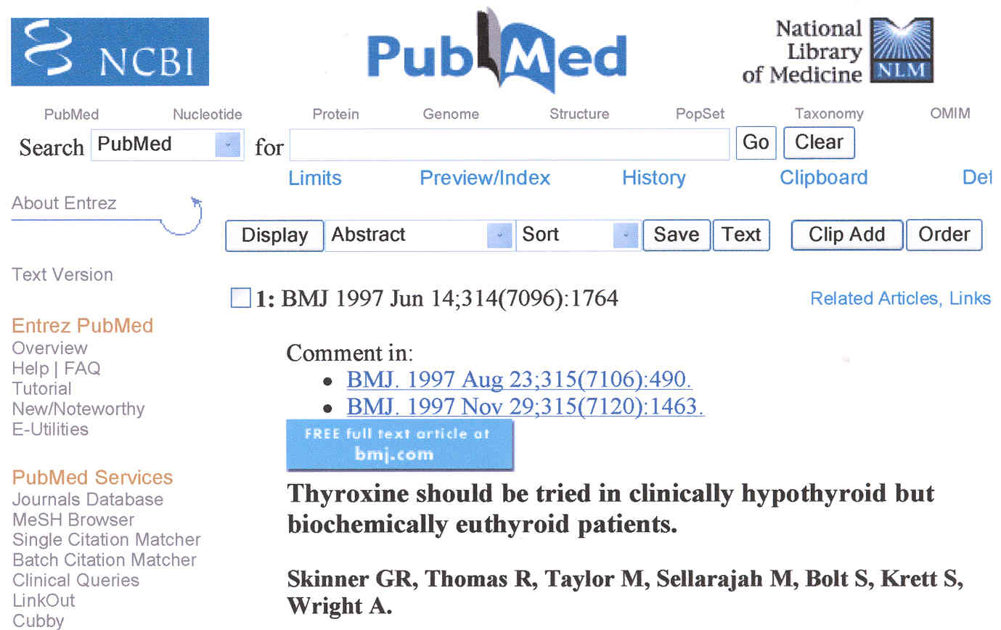
95 %
REFERENCE
INTERVAL
We wish to question present medical practice, which considers abnormal serum concentrations of free thyroxine and TSH - those outside the 95% reference interval - to indicate hypothyroidism but incorrectly considers “normal” free thyroxine and thyroid stimulating hormone concentrations to negate this diagnosis.

Slide 3
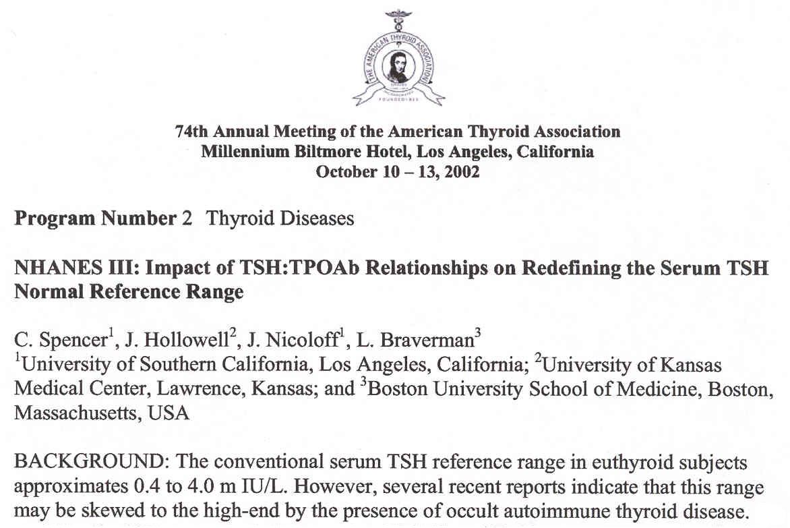
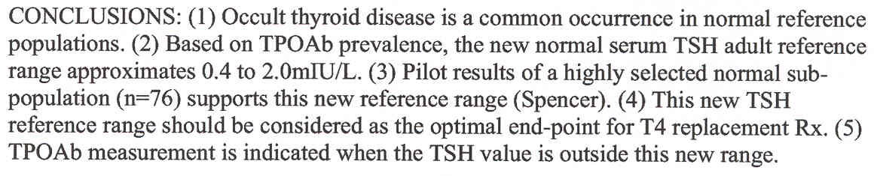
TSH LIMITS

Slide 4
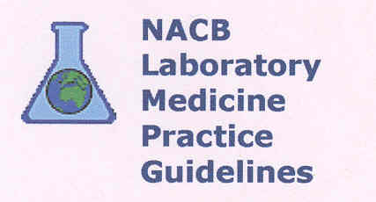
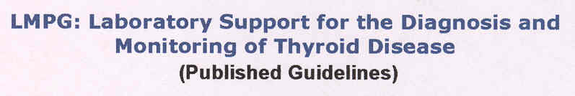
TSH
LIMITS
Guideline 22. TSH Reference Intervals
TSH Upper Reference Limits
It is likely that the upper limit of the serum TSH euthyroid reference range will be reduced to 2.5 mIU/L because >95% of rigorously screened normal euthyroid volunteers have serum TSH value between 0.4 and 2.5 mIU/L.

Slide 5
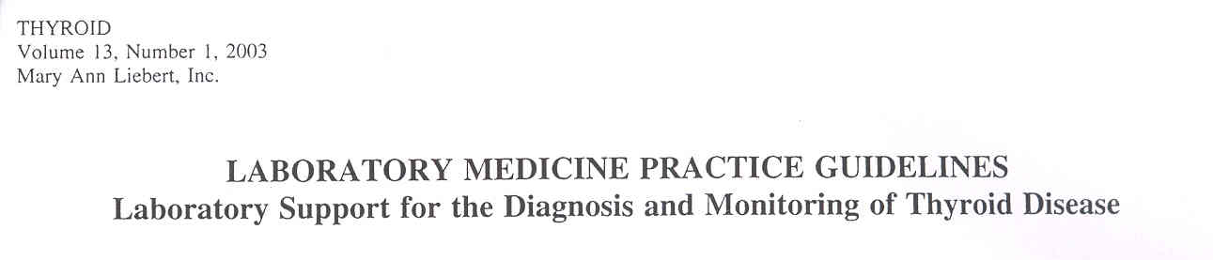
TSH REFERENCE RANGE
The majority (>95%) of healthy euthyroid subjects have a serum TSH concentration below 2.5 mIU/L. Ambulatory patients with a serum TSH above 2.5 mIU/L, when confirmed by a repeat TSH measurement made after 3-4 weeks, may be in the early stages of thyroid failure, especially if TPO Ab is detected.

Slide 6
TSH REFERENCE RANGE
Over the last two decades, the upper reference limit for TSH has steadily declined from ~ 10 to approximately ~ 4.0 - 4.5 mlU/L. This decrease reflects a number of factors including the improved sensitivity and specificity of current assays. The recent follow-up study of the Whickham cohort has found that individuals with a serum TSH > 2.0 mlU/L at their primary evaluation had an increased odds ratio of developing hypothyroidism over the next 20 years.

Slide 7
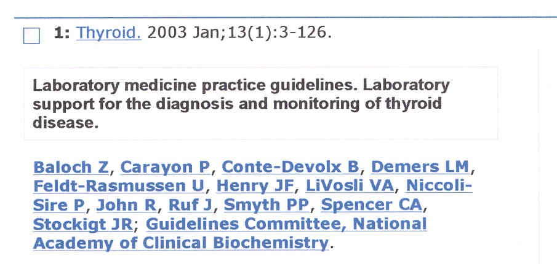
TSH REFERENCE RANGE
In the future, it is likely that the upper limit of the serum TSH euthyroid reference range will be reduced to 2.5 mlU/L because >95% of rigorously screened normal euthyroid volunteers have serum TSH value between 0.4 and 2.4 mlU/L.

Slide 8

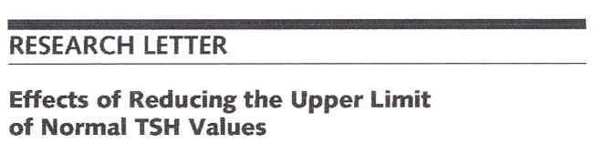
TSH REFERENCE RANGE
When individuals with thyroid autoantibodies, goiter, or a strong family history of thyroid disease are excluded, the upper bound of the 95% TSH concentration reference range decreases to between 2.5 and 3.0 mIU/L.

Slide 9
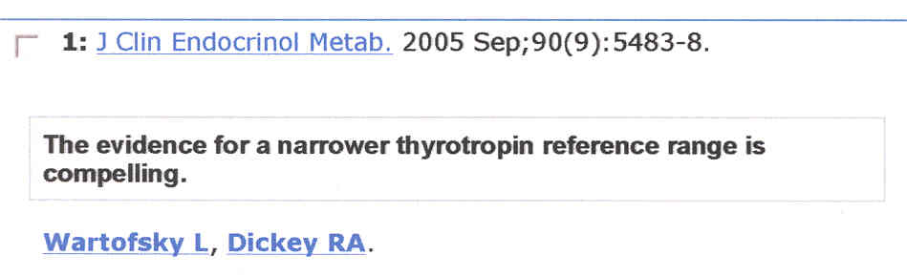
TSH REFERENCE RANGE
Debate and controversy currently surround (…) the definition of the normal reference range for TSH. It has become clear that previously accepted reference ranges are no longer valid as a result of both the development of more highly sensitive TSH assays and the appreciation that reference populations previously considered normal were contaminated with individuals with various degrees of thyroid dysfunction that served to increase mean TSH levels for the group.

Slide 10
TSH REFERENCE RANGE
Recent laboratory guidelines from the National Academy of Clinical Biochemistry indicate that more than 95% of normal individuals have TSH levels below 2.5 mU/liter. (…) Importantly, data indicating that African-Americans with very low incidence of Hashimoto thyroiditis have a mean TSH level of 1.18 mU/liter strongly suggest that this value is the true normal mean for a normal population.

Slide 11
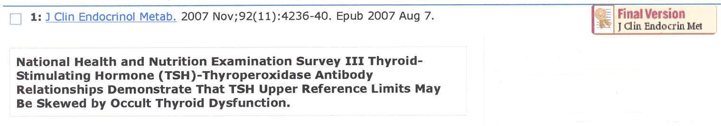
TSH REFERENCE
RANGE
Conclusions:
TSH upper reference limits may be skewed by TPOAb-negative individuals with occult autoimmune thyroid dysfunction.

Slide 12
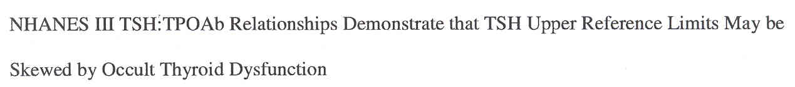
TSH REFERENCE RANGE
The American Association of Clinical Endocrinologists has recommended the adoption of a TSH upper limit of 3.0 mlU/L - a value close to the TSH upper limit determined for populations with a low prevalence of thyroid autoimmunity (i.e. NHAMES III blacks).

Slide 13
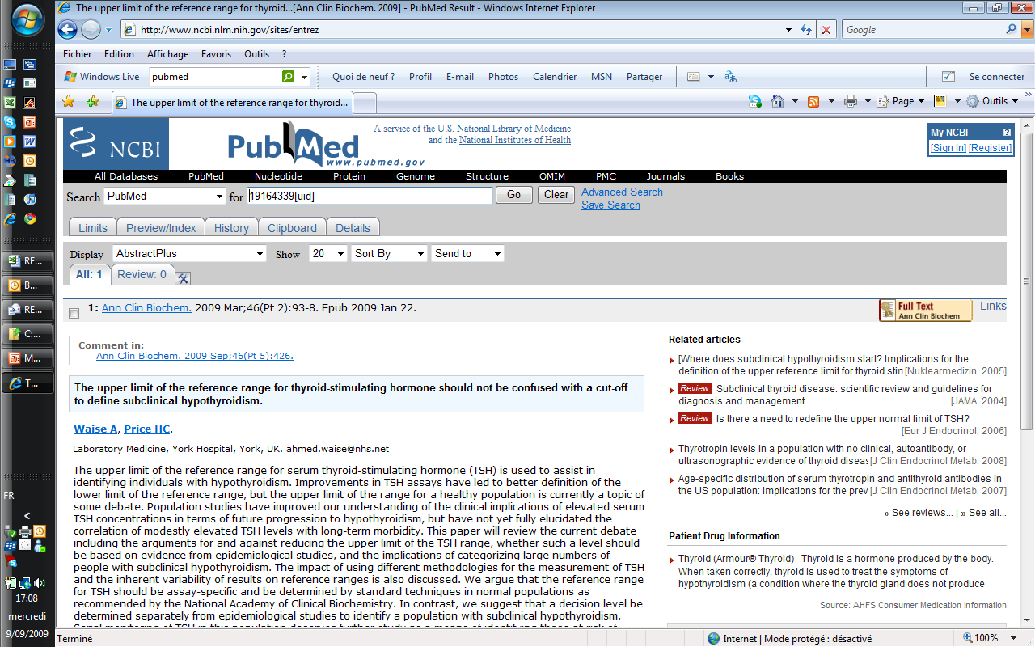
TSH REFERENCE RANGE
Decision cut-offs to diagnose and perhaps to consider treatment of mild hypothyroidism are a separate issue and should not be confused with the issue of defining reference ranges.

Slide 14
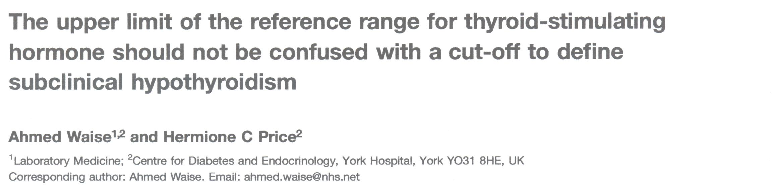
TSH REFERENCE RANGE
Such cut-offs may well be lower than the upper limit of reference range reported in many assays and recent studies suggest perhaps between 2.5 mU/L and 3.0 mU/L.

Slide 15
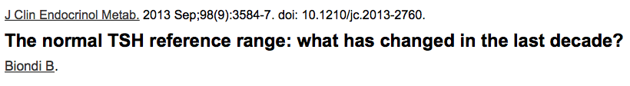
TSH REFERENCE RANGE
L-thyroxine has been found to exert a beneficial effect on atherogenic lipid profile and impaired vascular function in patients with TSH levels between 2.5 and 4.5 mlU/L.

Slide 16
T 4 AND HEALTH
A large body of evidence, which began to emerge in 2005, indicates that differences in thyroid function within the euthyroid reference range are associated with negative health outcomes.

Slide 17
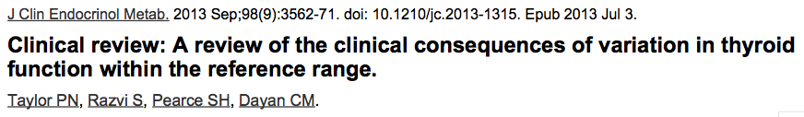
T 4 AND HEALTH
CONCLUSION: Common variation in persons with thyroid function in the normal range are associated with adverse health outcomes. These data suggest, by extrapolation, that carefully monitored treatment of even modest elevations of TSH may have substantial health benefits.

